Slide 1
Patterns of Coding with Agentic AI
at Hack for Good / Agile 2025

Slide 2
game rules have changed
cost(software) ≈ cost(changes)
cost(start) ≈ 0
& cost(software) ≈ cost(changes)

Slide 3
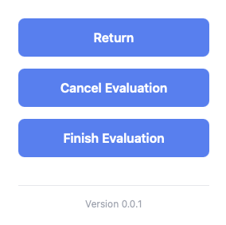

Slide 4
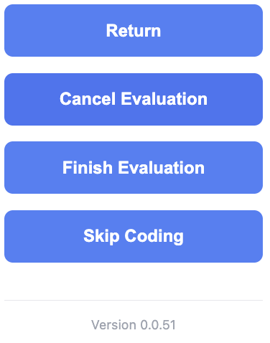

Slide 5
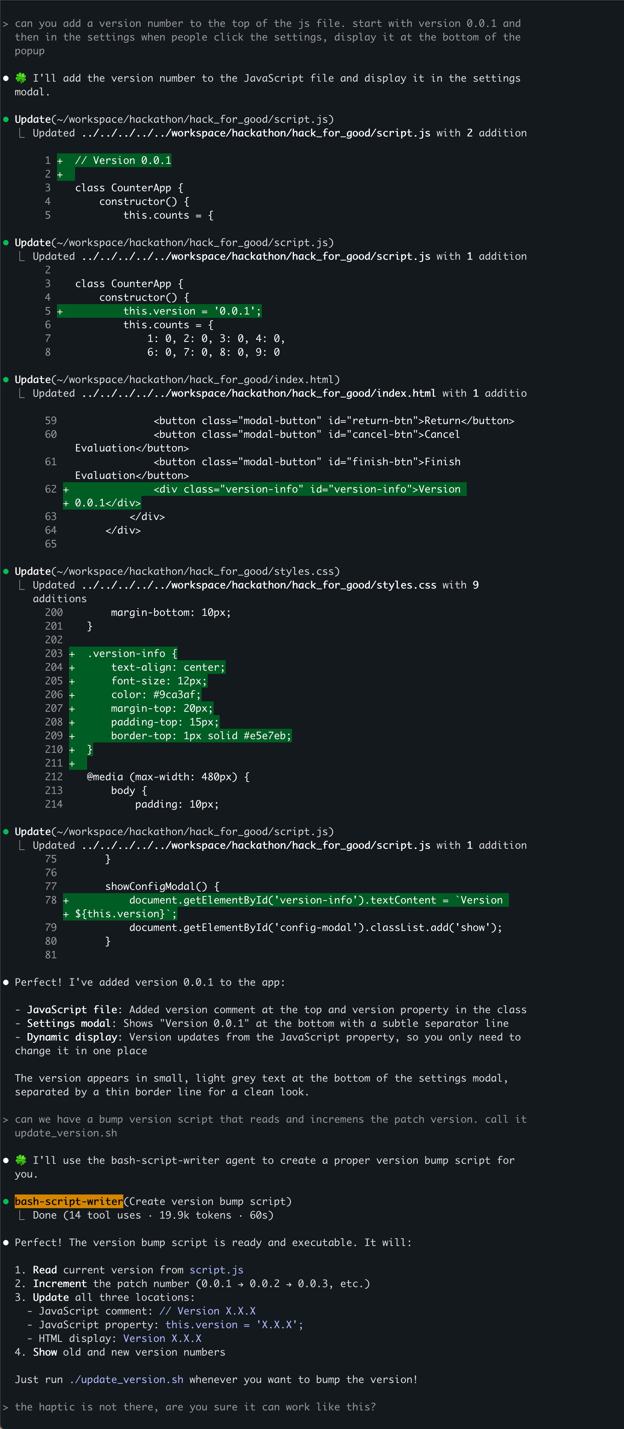

“Please add a version number”
add conversation
1

Slide 6
“Please add a version number”
add conversation
1

Slide 7

add version number

Slide 8
“Please add a version number”
add conversation
1

Slide 9
“Please add a version number”
add conversation
1

Slide 10

update_version.sh

Slide 11
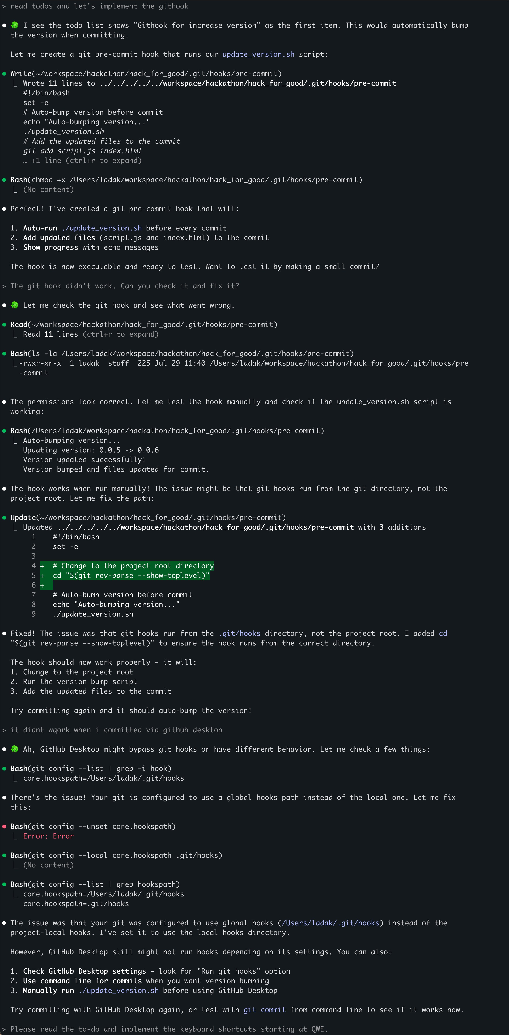
1

Slide 12
1

Slide 13
1

Slide 14
git commit hook

Slide 15
vs
“Show the version number in the config and always increment it when we make a new feature”

Slide 16


version
number
update_
version.sh
githook

Slide 17
concept
Managing complexity

Slide 18
concept
Focus AI
one little step at a time

Slide 19
concept
Squeeze determinism out of your AI
everything that can be deterministic should be

Slide 20
concept
Building your own tools
cost(small tool) ≈ 0

Slide 21
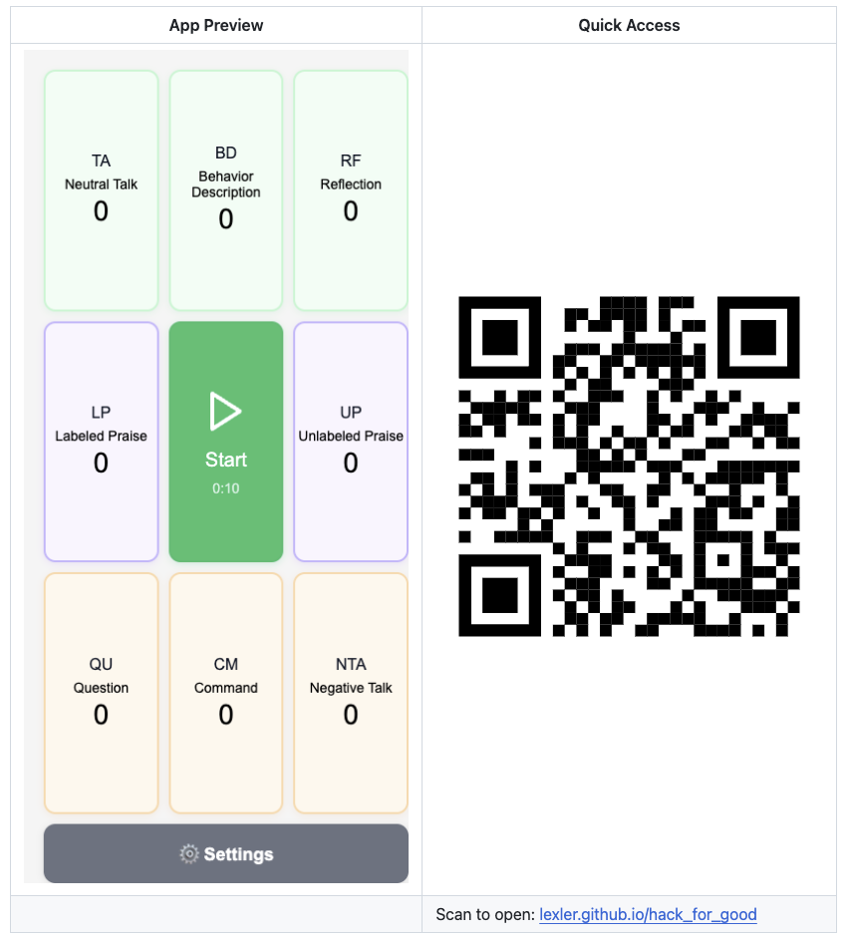

Slide 22
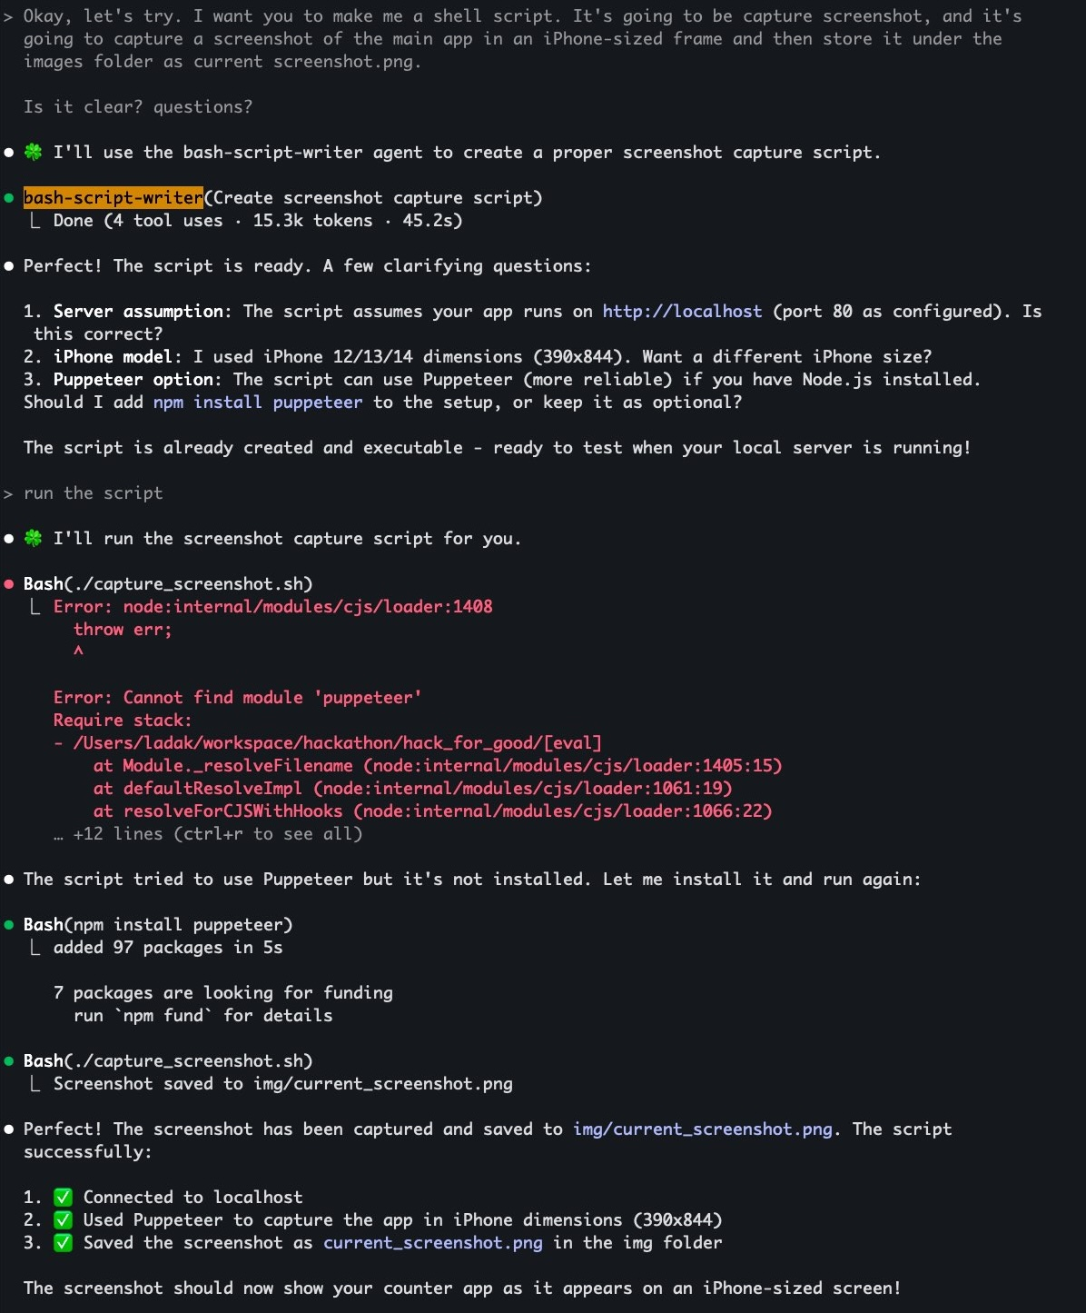

1

Slide 23
1

Slide 24
1

Slide 25

capture_screenshot.sh

Slide 26
Managing complexity
small steps, focused AI
fast feedback loops
script everything you can

Slide 27
pattern
Diagraming in ASCII
default to text for everything
markdown : code = ASCII : images

Slide 28
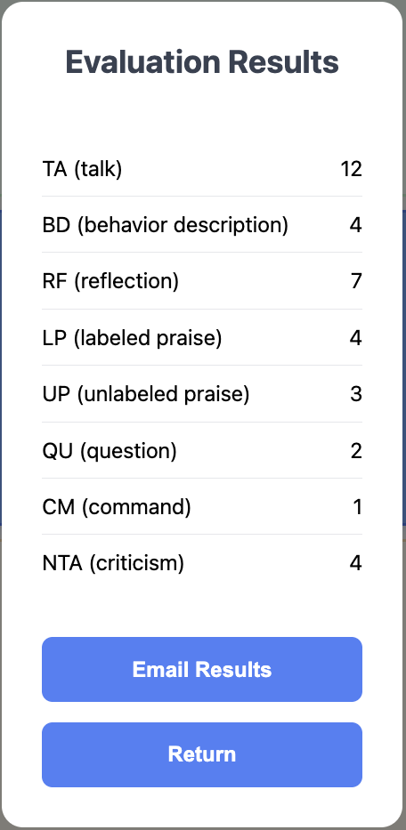
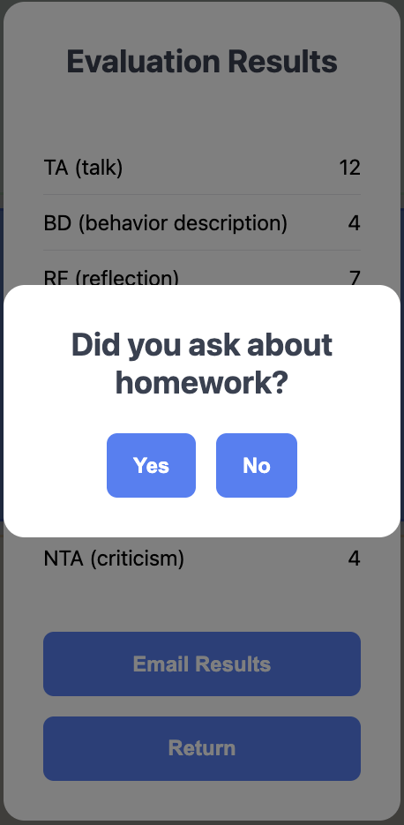
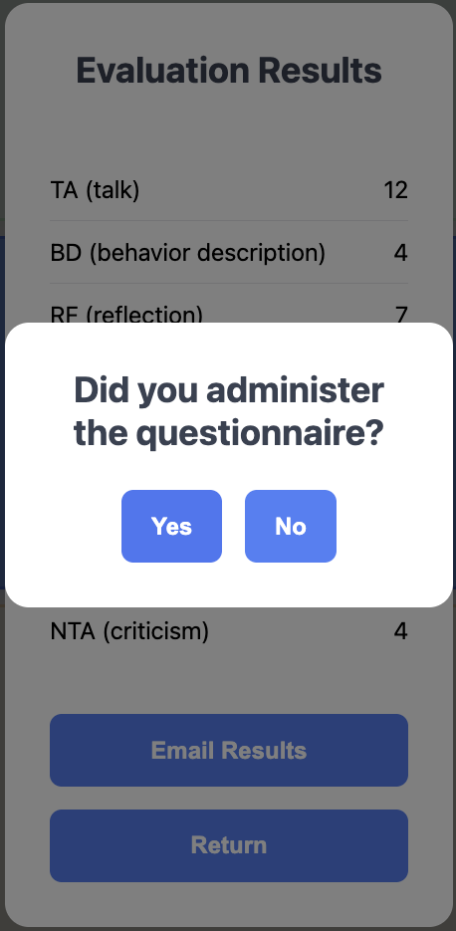


Slide 29
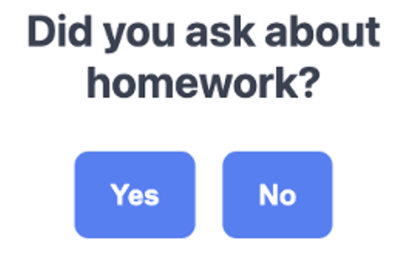
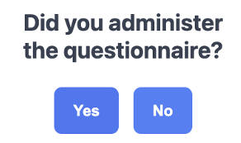
yes/no questions =
self-reporting
❌
✅
> How many times did they do homework this week?
“5” / “didn’t ask”
> What was the ECBI or WACB score?
“31” / “didn’t ask”
✅

Slide 30
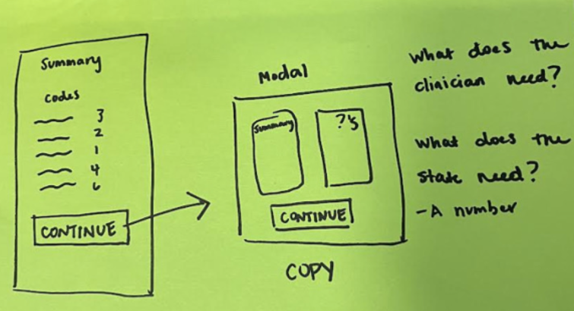
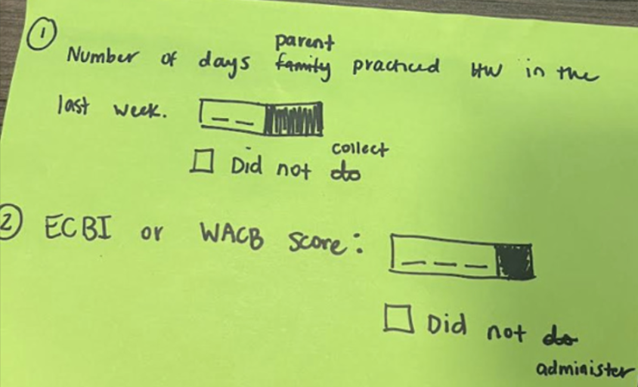

Slide 31
create markdown document

Slide 32
1

Slide 33
1

Slide 34
1

Slide 35
1

Slide 36
1

Slide 37
1

Slide 38
1

Slide 39
1

Slide 40
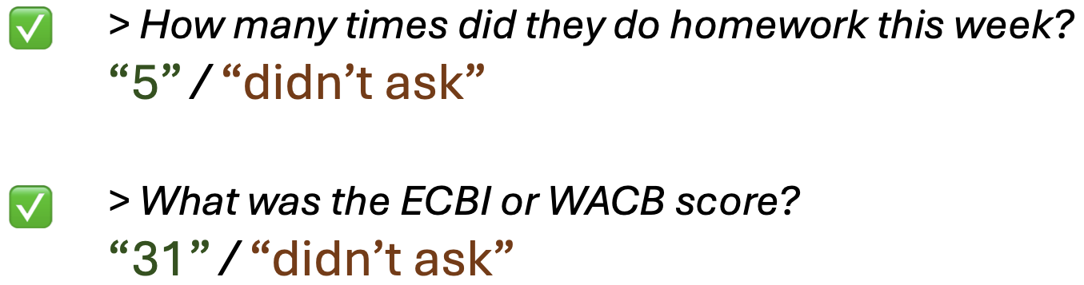
1

Slide 41
1

Slide 42
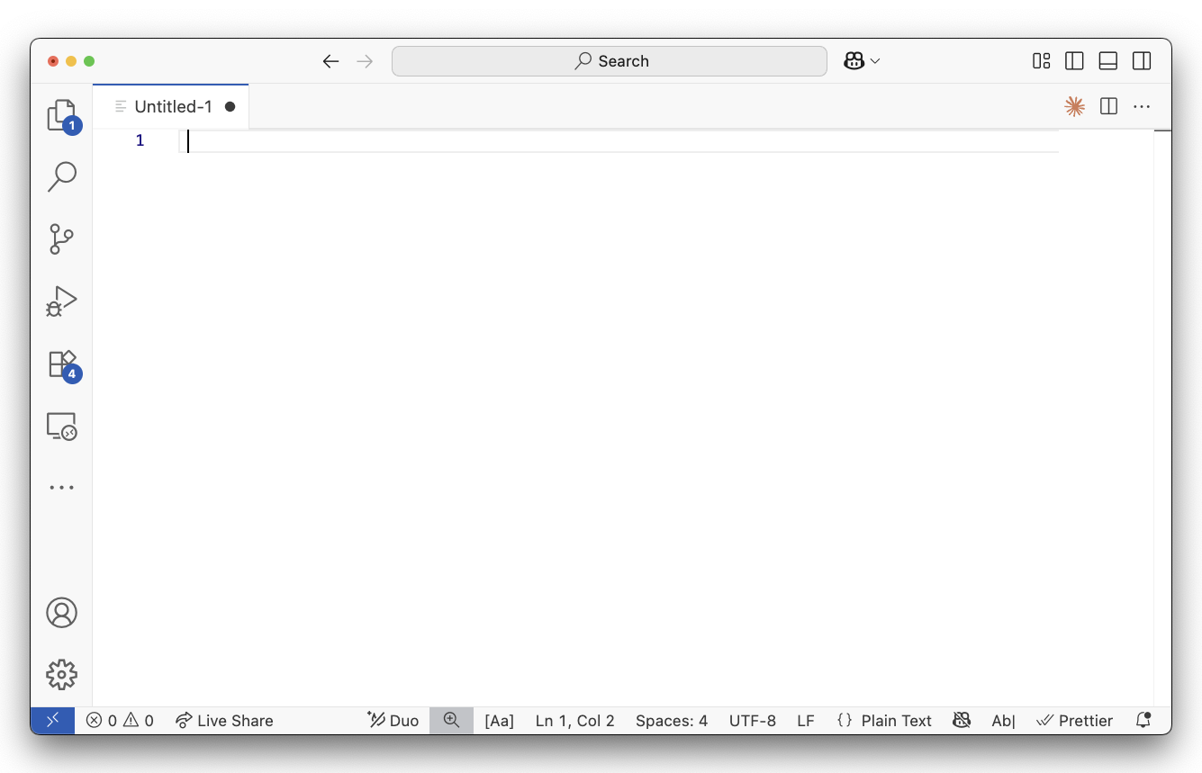
┌─────────────────────────────────────┐
│ Modal │
│ │
│ ┌─────────┐ ┌─────────────────────┐ │
│ │Summary │ │Question subpanel │ │
│ │ │ │ │ │
│ │ │ │1. Number of days │ │
│ │ │ │ practiced [____] │ │
│ │ │ │ ☐ Did not collect │ │
│ │ │ │ │ │
│ │ │ │2. ECBI/WACB score: │ │
│ │ │ │ [____] │ │
│ │ │ │ ☐ Did not │ │
│ │ │ │ administer │ │
│ └─────────┘ └─────────────────────┘ │
│ │
│ ┌─────────────────────────────────┐ │
│ │ CONTINUE │ │
│ └─────────────────────────────────┘ │
└─────────────────────────────────────┘
┌─────────────────────────────────────┐
│ Modal │
│ │
│ ┌─────────┐ ┌─────────────────────┐ │
│ │Summary │ │Question subpanel │ │
│ │ │ │ │ │
│ │ │ │1. Number of days │ │
│ │ │ │ practiced [____] │ │
│ │ │ │ ☐ Did not collect │ │
│ │ │ │ │ │
│ │ │ │2. ECBI/WACB score: │ │
│ │ │ │ [____] │ │
│ │ │ │ ☐ Did not │ │
│ │ │ │ administer │ │
│ └─────────┘ └─────────────────────┘ │
│ │
│ ┌─────────────────────────────────┐ │
│ │ COPY & EMAIL RESULTS │ │
│ └─────────────────────────────────┘ │
└─────────────────────────────────────┘

Slide 43
1

Slide 44
1

Slide 45
create markdown document
✅

Slide 46
create todo list

Slide 47
1

Slide 48
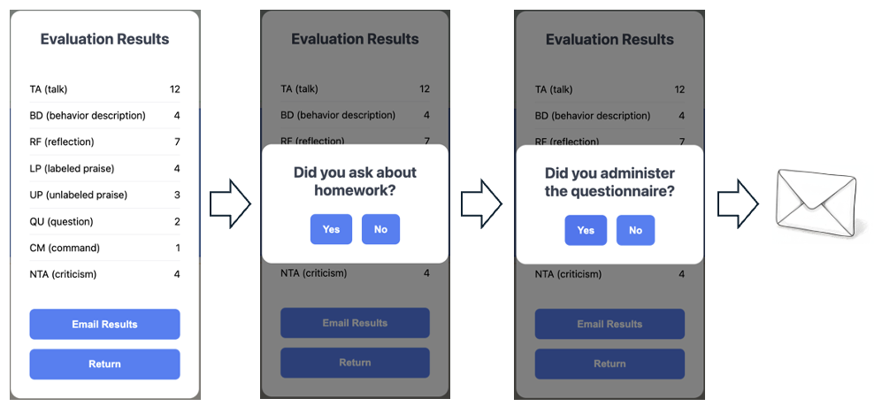
1

Slide 49
1

Slide 50
1

Slide 51
create todo list
✅

Slide 52

make the change

Slide 53
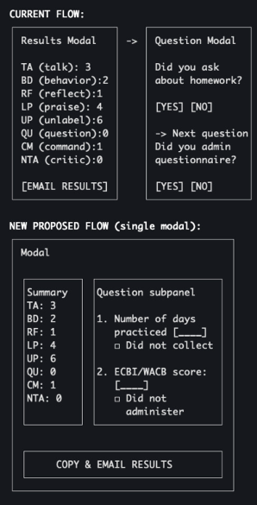
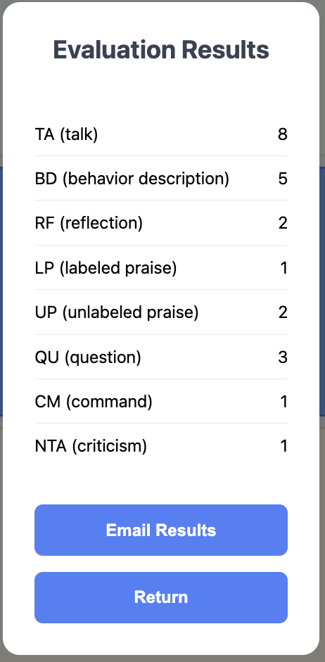
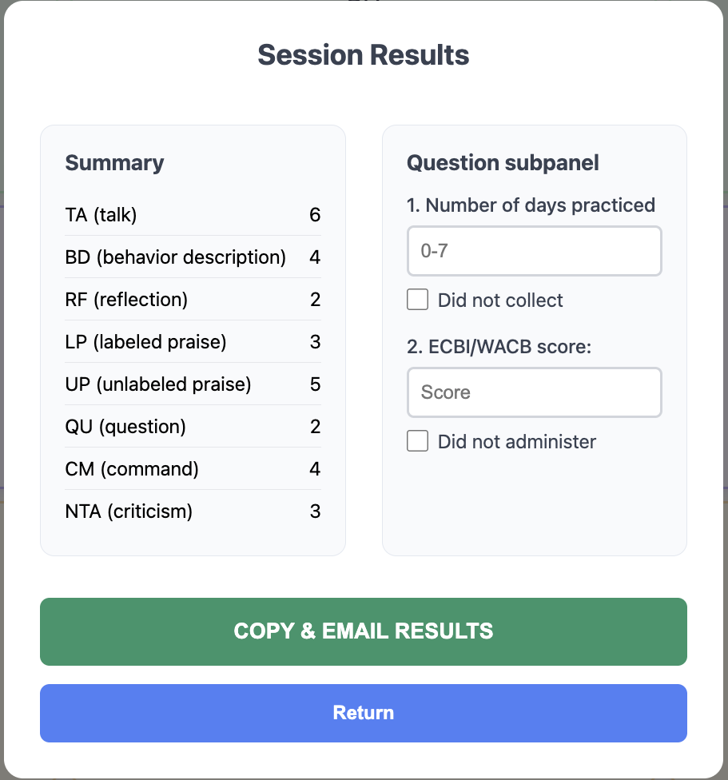

Slide 54
markdown
document
of UI in ASCII
todo
change
delta
change code
What do we want?
How do we get there?
Making the change

Slide 55
Managing complexity
small steps
focus AI
fast feedback loops
script everything you can
staying in text (ASCII)

